Slide 1
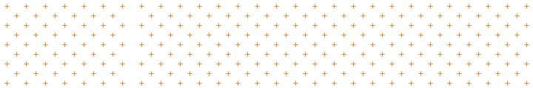
Fundamentals of Human-Centered Design
Day 2
Peter Gorman | peter.gorman@opm.gov
Mina Jafarpoor | mina.jafarpoor@opm.gov
Judy Conley | judy.conley@navy.mil
Nick Jones | nicholas.j.jones1@navy.mil
Notes:
JC

Slide 2

Regroup:
Reconnect + Review
Notes:
JC

Slide 3
Welcome to Day 2!
How’s everyone doing?
Reconnect + Review
Any thoughts since yesterday?
Notes:
JC

Slide 4
Day 2 Agenda
Reconnect + Review
Regroup: Reconnect + Review
UNDERSTAND: Insight Synthesis
Break
ENVISION: Idea Generation
Lunch 12:00-1:00
ENVISION: Prioritizing Ideas
ENVISION: Visualizing Concepts
Break
PROTOTYPE: Learning by Making
Reflect: Debrief + Preview
Wrap up 4:00
Notes:
JC

Slide 5
UNDERSTAND:
Insight Synthesis
Notes:
MJ

Slide 6
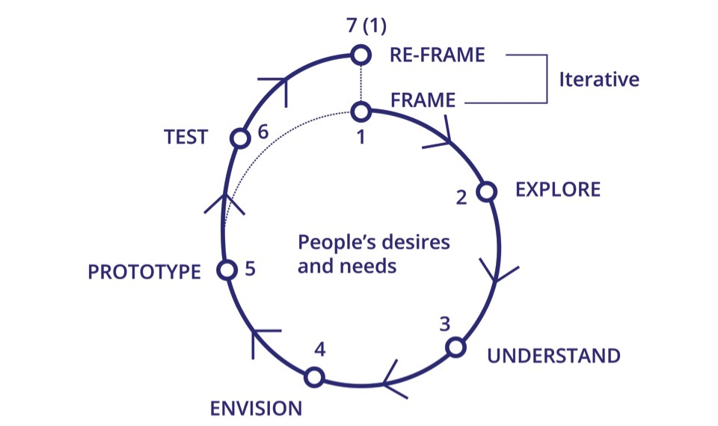
HCD Process Revisited
Insight Synthesis
Notes:
MJ

Slide 7
Insight Synthesis: A Definition
The process of uncovering the meaning behind data collected about people’s needs.
Insight Synthesis
In order to bring clarity to complex data sets and identify useful insights and patters, we must be organized and adaptable.
Notes:
MJ

Slide 8





Data Processing
Insight Synthesis
“
“
“
“
Notes:
MJ

Slide 9
Data Sharing
Insight Synthesis
WALL
“
“
“
“
Quotations
Observations
Photographs
Notes:
MJ

Slide 10
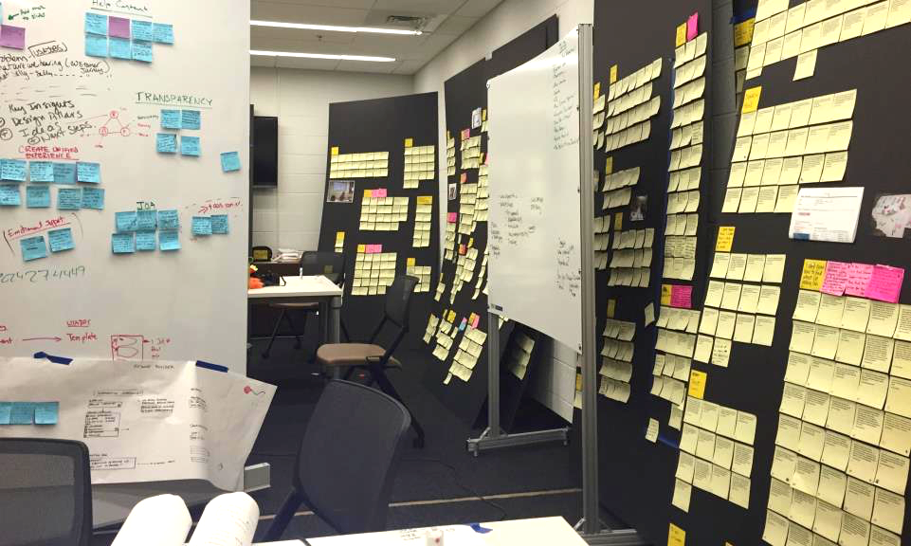
USAJobs Synthesis
Insight Synthesis
Notes:
MJ

Slide 11
USAJobs Synthesis: Step 2
Insight Synthesis
“Applying for Federal jobs is going to be a long drawn out process and you will have your heart broken at the end of it.”
Single transcribed data point.
“In USAJOBS a lot of language is extremely confusing, the structure of job announcements is not user friendly, interaction with our agency is clunky and we lose applicants along the way.”
“Is this website made so complicated so people won’t apply for jobs? USAJOBS is the most complicated system I have ever used. It is very daunting to spend that much time applying without ever getting a response.”
“If you have questions about USAJOBS you have to figure it out on your own. I check with social media to get an understanding of the website.”
"I don't know what keywords to use since there are so many"
"I do search on my own in USAJOBS but what I have experienced - I may be looking for a physical science technician but it may not always be listed as physical science- if I type that in it will limit me and i could not get the right results"
"No I am not receiving help. I search on my own...Where is there help? That is one of the major complaint-there is no help to find"
"Usually when I hear i didn't make the list for consideration I don't care anymore. I tried that, you can't get in touch with anyone for an explanation. When you get through to someone they don't have answers for you."
Notes:
MJ

Slide 12
USAJobs Synthesis: Step 2
Insight Synthesis
Arduous Process
Finding Help
Feeling Lost
Lack of Guidance
"Usually when I hear i didn't make the list for consideration I don't care anymore. I tried that, you can't get in touch with anyone for an explanation. When you get through to someone they don't have answers for you."
"No I am not receiving help. I search on my own...Where is there help? That is one of the major complaint-there is no help to find"
"I do search on my own in USAJOBS but what I have experienced - I may be looking for a physical science technician but it may not always be listed as physical science- if I type that in it will limit me and i could not get the right results"
“Is this website made so complicated so people won’t apply for jobs? USAJOBS is the most complicated system I have ever used. It is very daunting to spend that much time applying without ever getting a response.”
“Applying for Federal jobs is going to be a long drawn out process and you will have your heart broken at the end of it.”
“If you have questions about USAJOBS you have to figure it out on your own. I check with social media to get an understanding of the website.”
"I don't know what keywords to use since there are so many"
“In USAJOBS a lot of language is extremely confusing, the structure of job announcements is not user friendly, interaction with our agency is clunky and we lose applicants along the way.”
Notes:
MJ

Slide 13
USAJobs Synthesis: Step 3
Insight Synthesis
Applying for a government job is a long and arduous process which is made even worse because the government doesn’t set user expectations up front about what they need to apply and how long it will take them.
USAJOBS falls short of applicant expectations because it presents itself as a one-stop shop for federal hiring, but in reality it is laid on top of a disjointed process spread among 129 agencies, which disorients, frustrates, and misleads users
USAJOBS does not communicate eligibility and qualifications in a way that is meaningful to individual applicants, nor explain that these are prerequisites to being considered; applicants apply to jobs they can’t get resulting in increased applications, workload for the government and frustration for multiple users in the system
Arduous Process
Finding Help
Feeling Lost
Lack of Guidance
"Usually when I hear i didn't make the list for consideration I don't care anymore. I tried that, you can't get in touch with anyone for an explanation. When you get through to someone they don't have answers for you."
"No I am not receiving help. I search on my own...Where is there help? That is one of the major complaint-there is no help to find"
"I do search on my own in USAJOBS but what I have experienced - I may be looking for a physical science technician but it may not always be listed as physical science- if I type that in it will limit me and i could not get the right results"
“Is this website made so complicated so people won’t apply for jobs? USAJOBS is the most complicated system I have ever used. It is very daunting to spend that much time applying without ever getting a response.”
“Applying for Federal jobs is going to be a long drawn out process and you will have your heart broken at the end of it.”
“If you have questions about USAJOBS you have to figure it out on your own. I check with social media to get an understanding of the website.”
"I don't know what keywords to use since there are so many"
“In USAJOBS a lot of language is extremely confusing, the structure of job announcements is not user friendly, interaction with our agency is clunky and we lose applicants along the way.”
Notes:
MJ

Slide 14
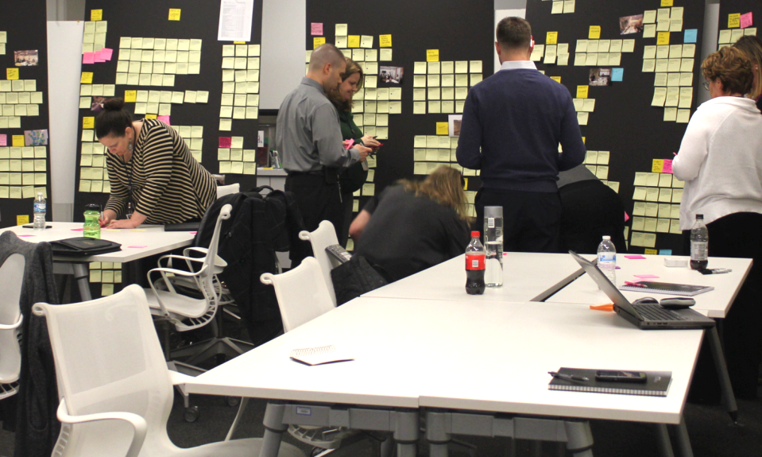
USAJobs Synthesis
Insight Synthesis
Notes:
MJ

Slide 15
Synthesis Process
Insight Synthesis
1. Extract Takeaways Review your notes and photos, and pull out any comments, quotations, or observations that could be important, and put them on sticky notes—one per sticky.
2. Categorize & Label Share your data with your group by placing your sticky notes together on the wall. Sort similar takeaways into clusters. Iterate, refine, and give each cluster a label.
3. Articulate Insights Discuss the deeper meaning and design opportunities suggested by the themes emerging from your data and distill each into a descriptive statement or “insight.”
Notes:
MJ

Slide 16
Insight Synthesis
Synthesis Overview
“
“
One person places and describes a single data point.
Notes:
MJ

Slide 17
Insight Synthesis
Synthesis Overview
“
“
“
“
Invite others to place items together to create meaningful groups from inferences.
Notes:
MJ

Slide 18
Synthesis Overview
Insight Synthesis
Meaning is generated by asking questions like:
What is this saying about a particular context?
What caused or prompted the person to think/say this?
If I read between the lines, does it speak to something larger?
What about this situation would lead a person to say this or do this? (Go back and remember the context for this moment)
“
“
“
“
Invite others to place items together to create meaningful groups from inferences.
Notes:
MJ
Meaning is generated by asking questions like:
What is this saying about a particular context?
What caused or prompted the person to think/say this?
If I read between the lines, does it speak to something larger?
What about this situation would lead a person to say this or do this? (Go back and remember the context for this moment)

Slide 19
Insight Synthesis
Synthesis Overview
“
“
“
“
“
“
“
“
Invite others to place items together to create meaningful groups from inferences.
Notes:
MJ

Slide 20
Insight Synthesis
Synthesis Overview
“
“
“
“
“
“
“
“
“
“
“
“
“
“
Invite others to place items together to create meaningful groups from inferences.
Notes:
MJ

Slide 21
Insight Synthesis
Synthesis Overview
“
“
“
“
“
“
“
“
“
“
“
“
“
“
“
“
“
“
“
“
“
“
Invite others to place items together to create meaningful groups from inferences.
Notes:
MJ

Slide 22
Insight Synthesis
Synthesis Overview
“
“
“
“
“
“
“
“
Simple Label
“
“
“
“
“
“
“
“
“
“
Simple Label
“
“
“
“
Simple Label
As they take shape, label each cluster with a brief phrase. Think: “This relationship has something to do with _____.”
Notes:
MJ

Slide 23
Insight Synthesis
Synthesis Overview
“
“
“
“
“
“
“
“
“
“
“
“
“
“
“
“
“
“
Simple Label
“
“
“
“
Simple Label
Simple Label
Discuss, rearrange, and re-label as groupings emerge.
Notes:
MJ

Slide 24
Insight Synthesis
Synthesis Overview
Insight
“
“
“
“
Insight
“
“
“
“
“
“
“
“
“
“
Insight
“
“
“
“
Simple Label
“
“
“
“
Simple Label
Simple Label
Distill each grouping into a compelling design insight.
Notes:
MJ

Slide 25
A single phrase that exhibits a deeper understanding of a person, a thing, or situation and embodies opportunities for design.
Insight Synthesis
What’s a Design Insight?
Notes:
MJ

Slide 26
Insight Synthesis
What Isn’t a Design Insight?
Data (Insights call for action.)
Observations (Without the motivation or need suggested by the observation)
Wishes (Ask people what they want, and they’ll tell you “a faster horse.”)
Notes:
MJ

Slide 27
Break
15 min.
Notes:
MJ

Slide 28

ENVISION:
Idea Generation
Notes:
PG

Slide 29
HCD Process Check-In
Idea Generation
Notes:
PG

Slide 30
Ideation: A Definition
Ideation is the creative process of generating, developing, and communicating new ideas within a design framework.
Idea Generation
Envisioning new futures requires building on other people’s ideas and "green housing" ideas that may feel unfinished or incomplete at the time.
Notes:
PG

Slide 31
The Spirit and Mindset of Ideation
Idea Generation
Yes, and…
Defer judgment
There is no right answer
Diversity is good
Work visually when possible
Everything is temporary
Take risks! Have fun!
Notes:
PG
The goal is quantity not quality (Quality comes later) / “write first, edit later” (they’re not the same)
No judging/trust : no idea is stupid, obvious, absurd, silly, impossible // but also: not trying to reach consensus (Consensus comes later) yes, and… Generate/Additive (Reductive comes later)
Magic wand it! How might we … without constraints? Money? Permission/approval? Tech?
Write, but maybe also draw. Just don’t let ideas disappear into the ether

Slide 32
Articulating Insights as Questions for Ideation
Insight Synthesis
How might we…?
Notes:
PG

Slide 33
Articulating Insights as Questions for Ideation
Insight Synthesis
How might we…?
Action/goal oriented
Notes:
PG

Slide 34
Articulating Insights as Questions for Ideation
Insight Synthesis
How might we…?
Action/goal oriented
Open-ended potential
Notes:
PG

Slide 35
Articulating Insights as Questions for Ideation
Insight Synthesis
How might we…?
Action/goal oriented
Open-ended potential
Collaborative + inviting
Notes:
PG

Slide 36
Articulating Insights as Questions for Ideation
Insight Synthesis
How might we…?
[Good question—let’s brainstorm!]
Notes:
PG

Slide 37
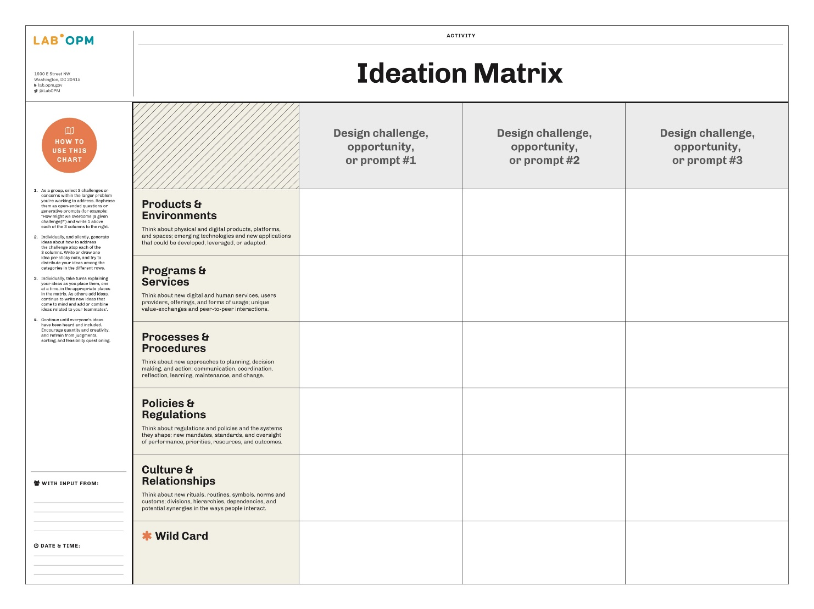
Ideation Process
Idea Generation
Notes:
PG

Slide 38
Ideation Process
Idea Generation
HMW Question #1
HMW Question #2
HMW Question #3
Notes:
PG

Slide 39
Ideation Process
Idea Generation
HMW Question #1
HMW Question #2
HMW Question #3
Notes:
PG

Slide 40
Lunch
Notes:
PG

Slide 41
ENVISION:
Prioritizing Ideas
Notes:
JC

Slide 42
Prioritizing Ideas
Prioritization Matrix
More Difficult
Less Important
More Important
Less Difficult
Notes:
JC

Slide 43
Prioritizing Ideas
Prioritization Process
Define “Important + Difficult” As a team, discuss what your specific definitions of importance and difficulty are.
Rank Ideas by Importance Then take your ideas and force rank them across the matrix from least to most important. This will require discussion and collaboration.
Rank Ideas by Difficulty Once in place on the horizontal axis, do not move your sticky notes horizontally. While keeping them in order, move them up or down depending on their difficulty in relation to one another.
Notes:
JC

Slide 44
Prioritizing Ideas
Prioritization Matrix
More Difficult
LUXURY
STRATEGIC
Less Important
More Important
LOW HANGING FRUIT
HIGH R.O.I.
Less Difficult
Notes:
JC

Slide 45
ENVISION:
Visualizing Concepts
Notes:
NJ

Slide 46
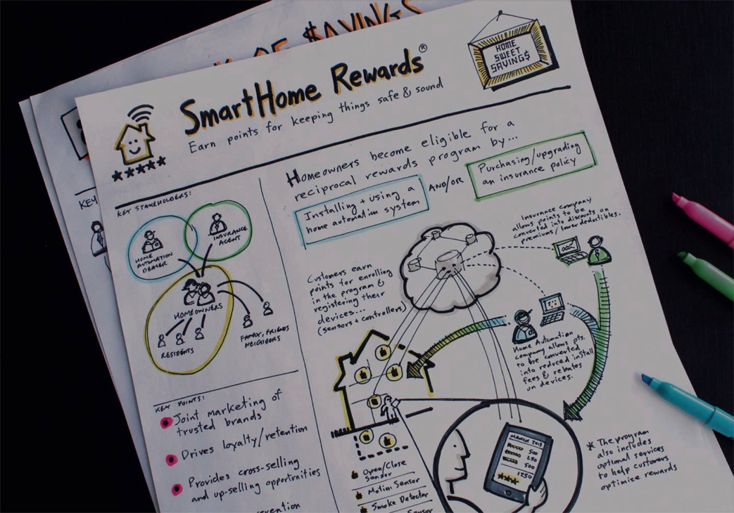
Concept Sketch
Visualizing Concepts
Notes:
NJ

Slide 47
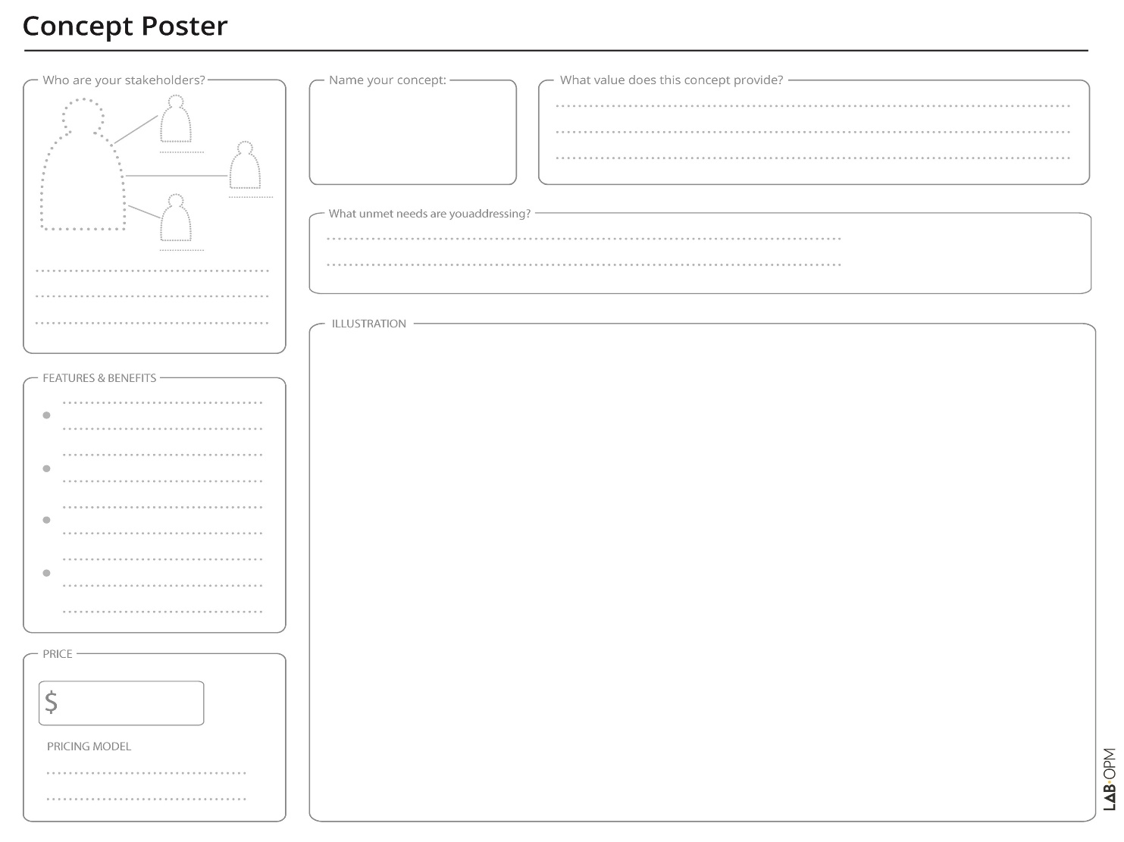
Concept Poster
Visualizing Concepts
Notes:
NJ

Slide 48
Break
15 min.
Notes:
NJ

Slide 49
PROTOTYPE:
Learning by Making
Notes:
PG

Slide 50
HCD Process Check-In
Learning by Making
Notes:
PG

Slide 51
Prototype: A Definition
A first simple model, draft, or version of a design or an idea that tests a concept or process in the real world.
Prototype:
A Definition
Learning by Making
Notes:
PG
Prototyping is a series of small experiments that helps us to better understand what we’re trying to build, the context or environments within which our product, service, or process will live, and to test our underlying/hidden assumptions.
can take many forms; it might be a sketch, a model made of cardboard, or a role-playing simulation of a service,
But must be tangible: Allows you to observe someone interact with, or ask for direct feedback about.

Slide 52
Why to Prototype?
Learning by Making
Tests designs in the real world.
Manages the risk of misplaced investment in the wrong solution.
Makes the abstract and intangible specific and concrete.
Makes ideas accessible for interaction and critique by others.
Enables collaboration & co-design
Notes:
PG

Slide 53
How to Prototype?
Learning by Making
Don’t waste time on little details. Don’t waste $ on fancy materials.
Work with what you have on hand to create props, personas, and Frankenstein monsters, whatever you need to do to see and feel what’s working and what’s not.
Seek to reveal, not conceal, flaws.
Notes:
PG

Slide 54
How to Prototype?
Learning by Making
Simple models or mock-ups will work for physical or digital designs, but less tangible services or experiences will need to be tested through performance, storyboarding, or other narratives.
Test pieces and parts of your design when the whole is not testable. Mix levels of fidelity, focusing on critical components.
Notes:
PG

Slide 55
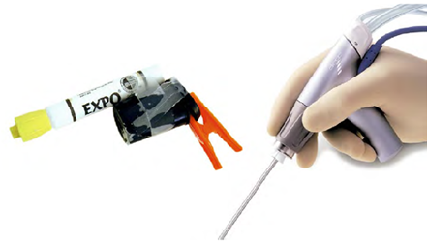
Prototyping Examples: Physical Models + Mockups
Learning by Making
Notes:
PG

Slide 56
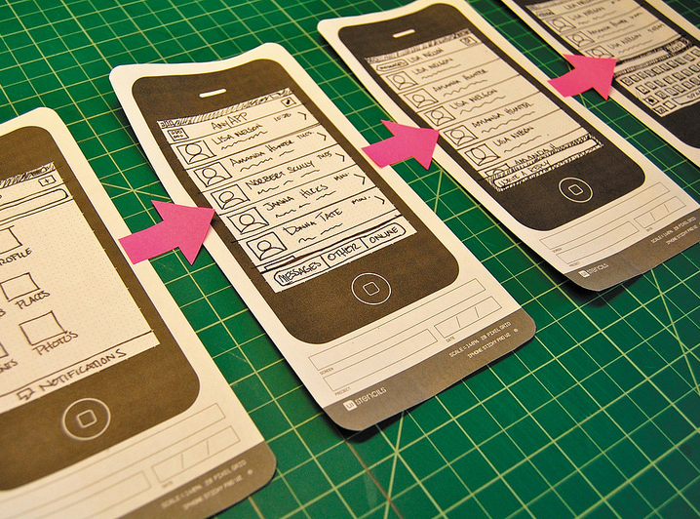
Prototyping Examples: Paper Prototypes
Learning by Making
Notes:
PG

Slide 57
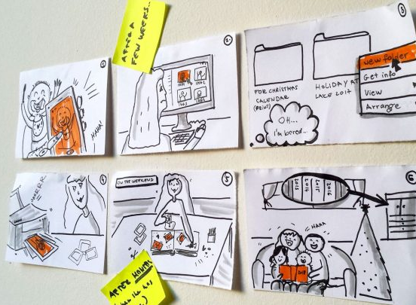
Prototyping Examples: Storyboards + Journeys
Learning by Making
Notes:
PG

Slide 58
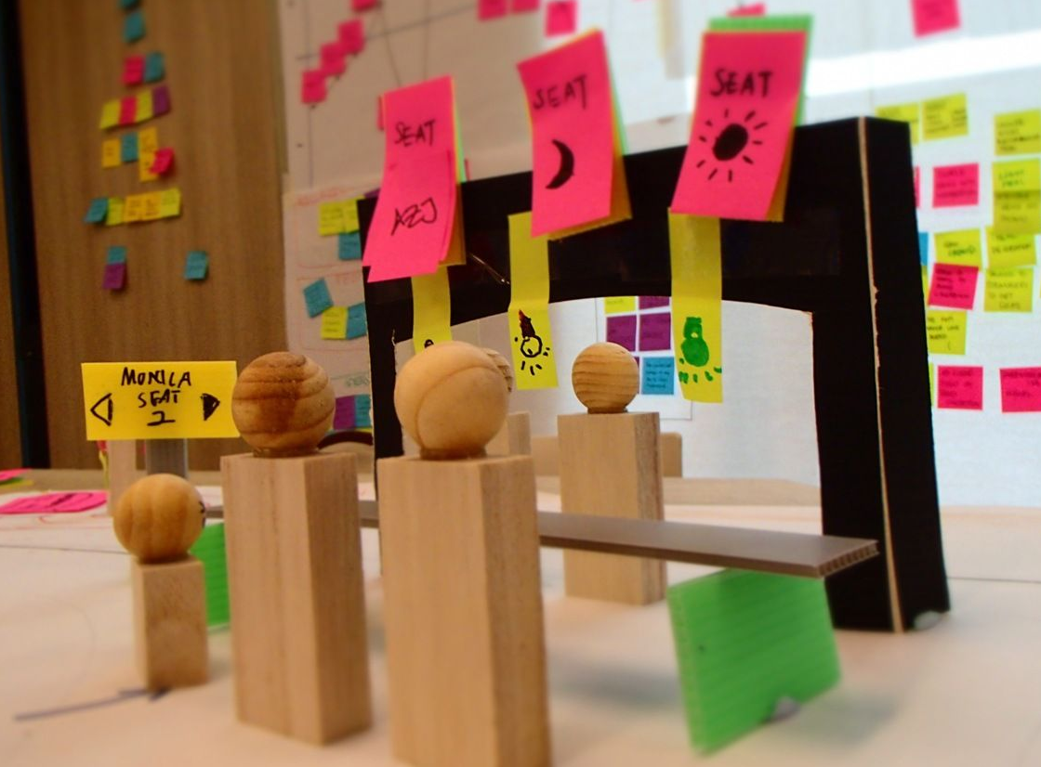
Prototyping Examples: Experience Models + Maps
Learning by Making
Notes:
PG

Slide 59
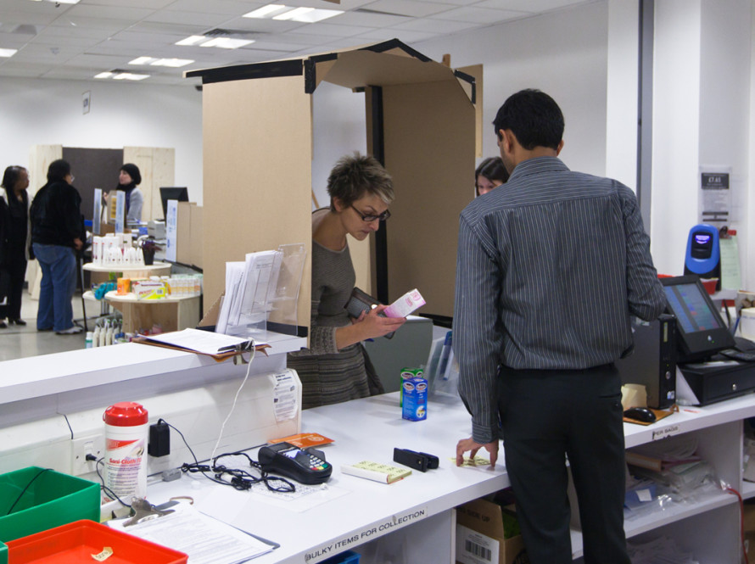
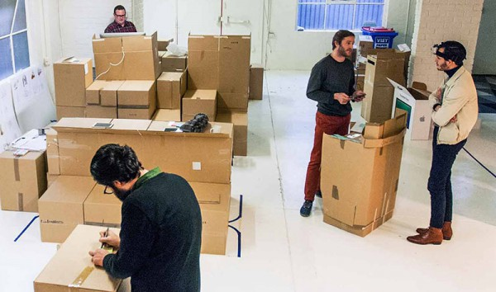
Prototyping Examples: Performance + Roleplay
Learning by Making
Notes:
PG
McDonalds “Speedee System”: https://youtu.be/jTageuhPfAM

Slide 60
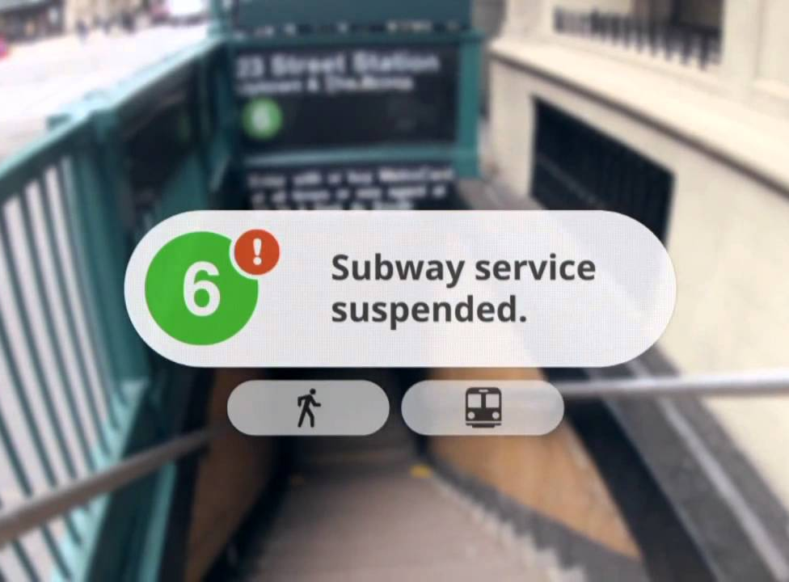
Prototyping Examples: Video + Animation
Learning by Making
Notes:
PG
Google Glass Video: https://www.youtube.com/watch?v=JSnB06um5r4

Slide 61
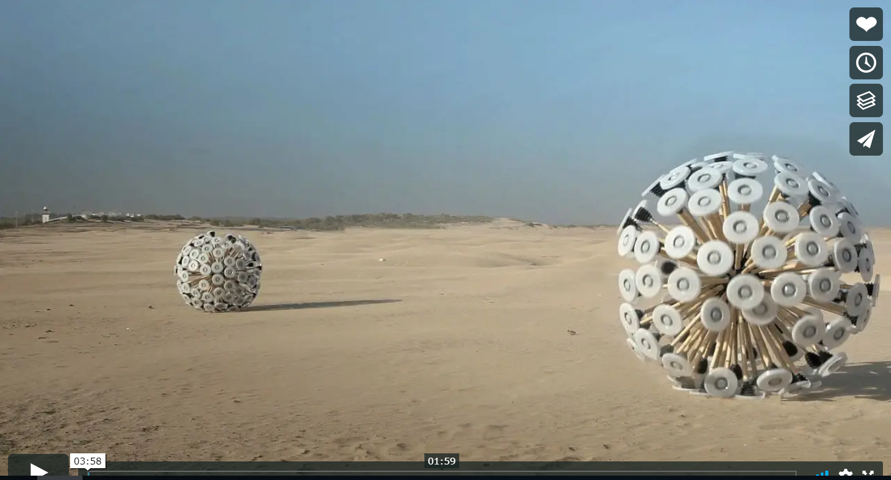
Prototyping Examples: Mine Kafon
Learning by Making
Notes:
PG
Wind powered landmine detector: https://vimeo.com/51887079

Slide 62
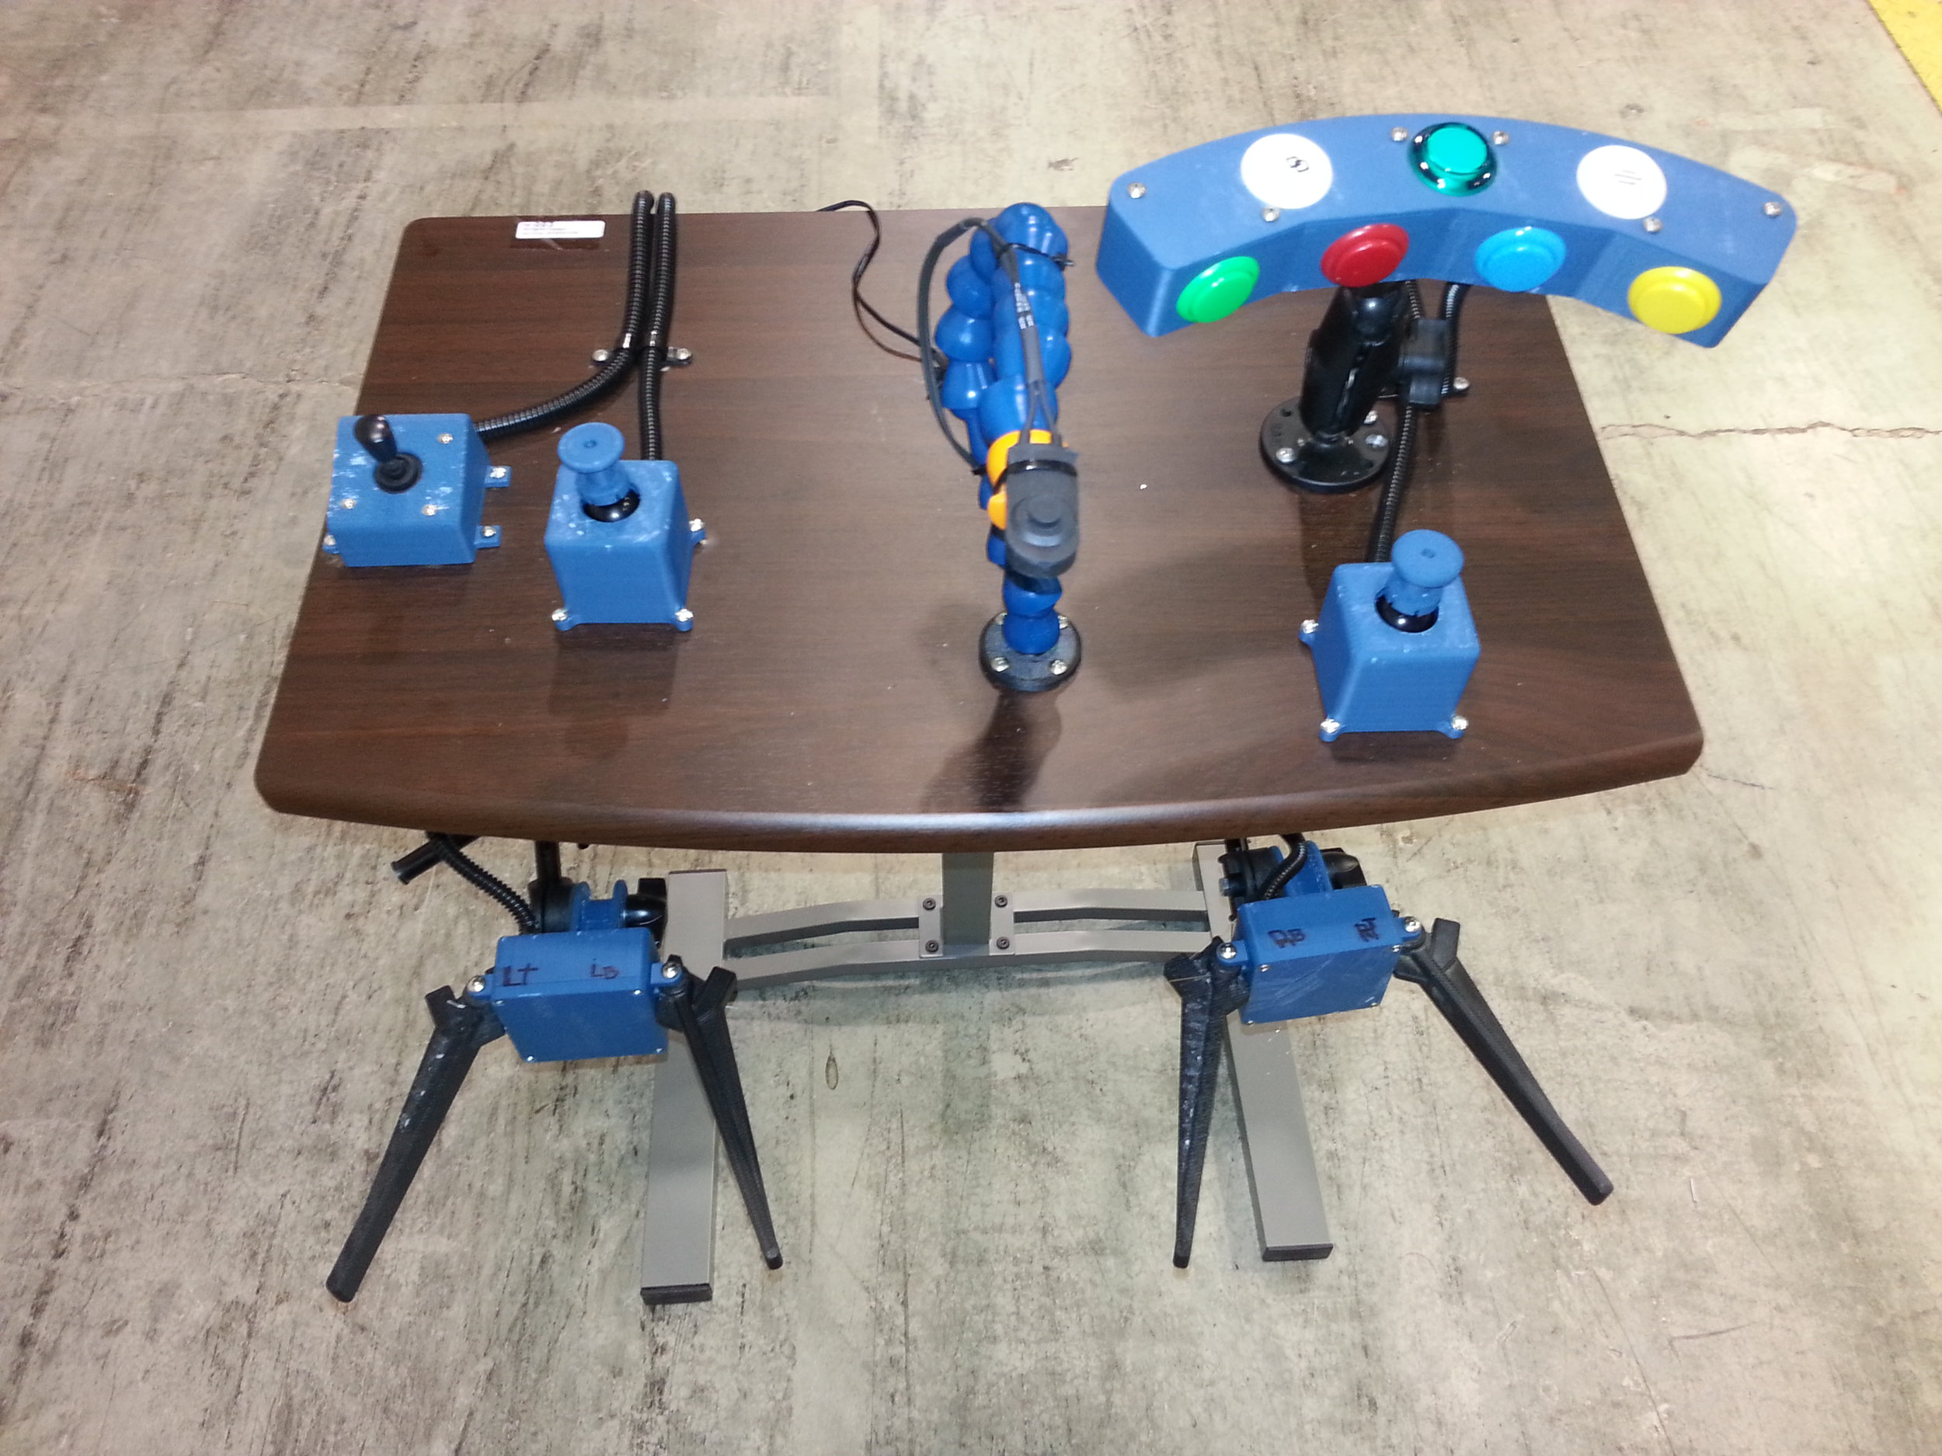
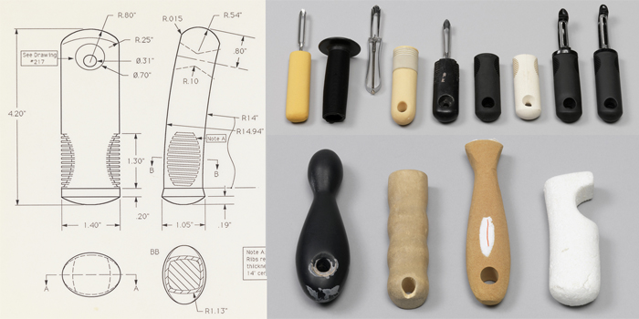
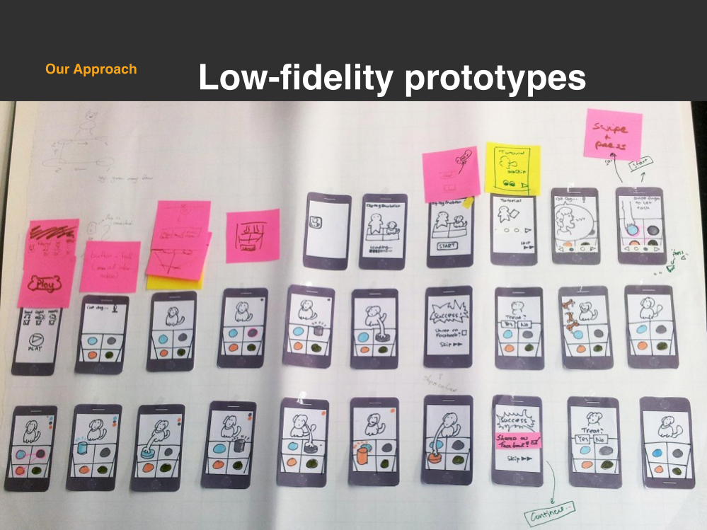
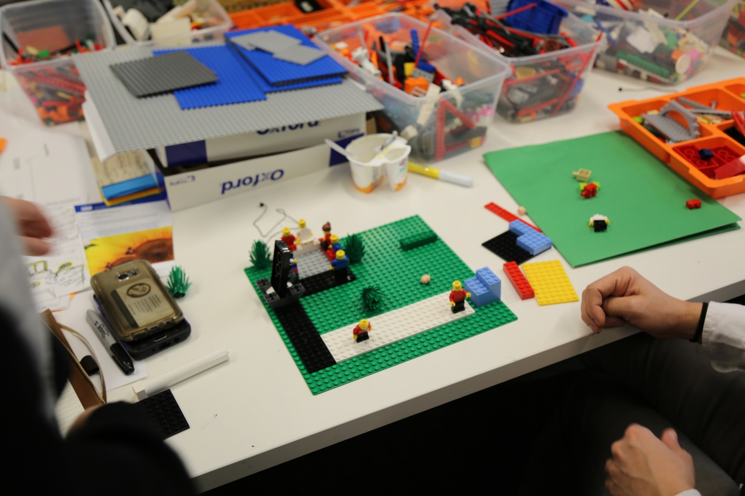
Time to build your own!
Learning by Making
Notes:
PG

Slide 63
Learning by Making
Prototyping Process
Decide What to Prototype Discuss which components of your design concept are particularly critical to its success and value. Determine which of these elements you need to learn more about through real-world prototyping and testing.
Develop Your Prototype Create a prototype that models one or multiple aspects of your design concept. Use the materials provided or seek out your own. Get creative and be resourceful.
Test Out Your Prototype Guide someone else (not in your group) through an interaction with your prototype. Observe what’s working and what’s not. Consider how to iterate and refine.
Notes:
PG

Slide 64
Reflect:
Debrief + Preview
Notes:
MJ

Slide 65
Daily Debrief
Fieldwork Debrief
What d’ya think?
I learned…
I wonder…
I was surprised…
I hope to…
I plan to…
What’s up next?
More work on your designs tomorrow.
Think about what + how to prototype.
Consider bringing prototyping materials.
We’ll aim to wrap up at 3pm tomorrow.
Rest up, and we’ll
see you tomorrow!
Notes:
MJ

Slide 66
Thank You
Notes:
MJ

